Slide 1
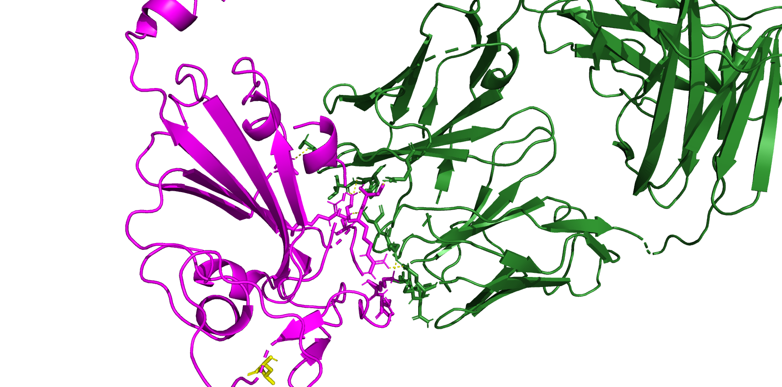
8dw9 BA286 (JN1 is after this)
A372
K440
T345
R508
K444
R346
L455

Slide 2
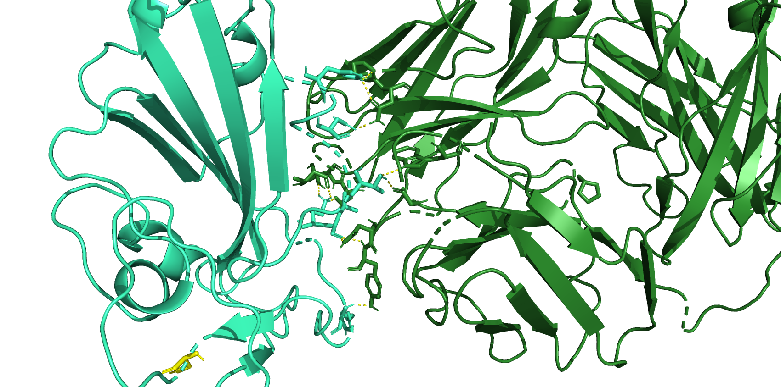
H339
N343
T345
K440
L441
H445
S455

Slide 3
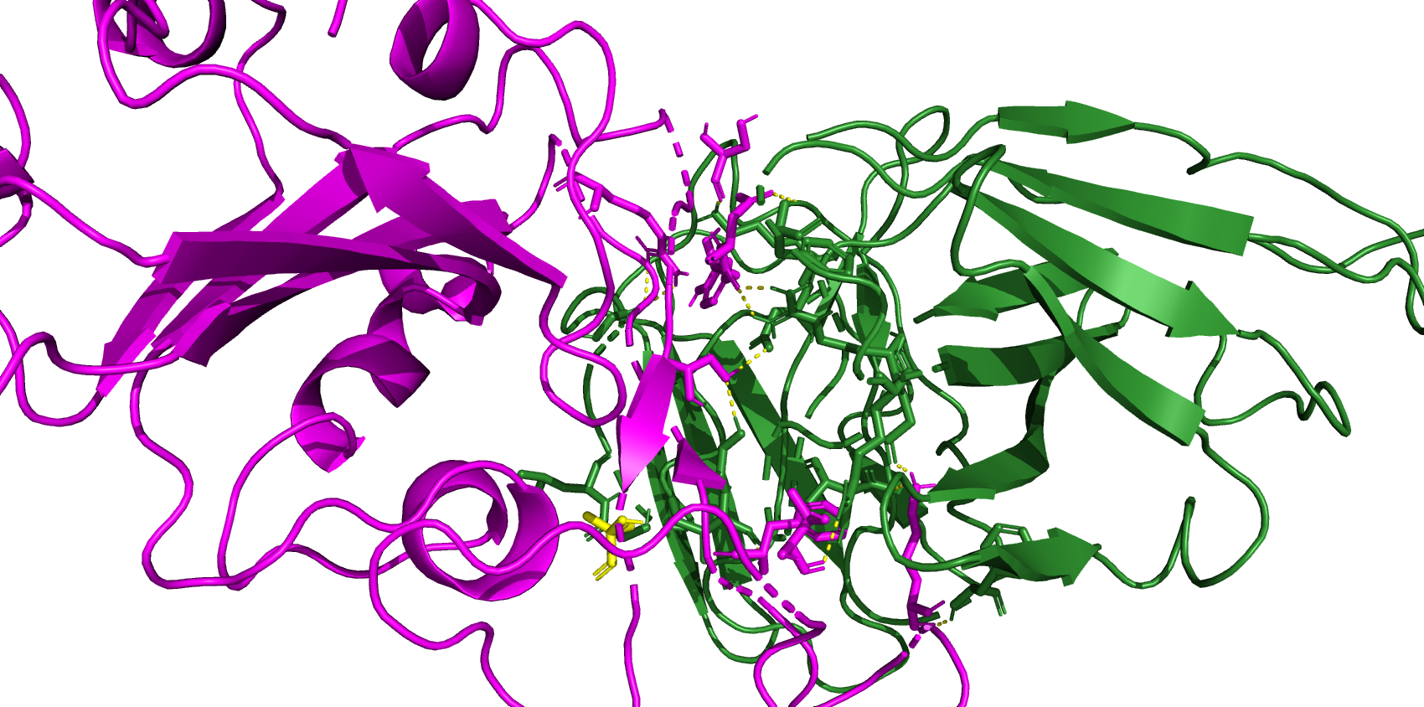
7xd2 BA.2.86 (jn.1 is after this)
R497
S446
D450
Y449
S493
I100
F489
K483
L455
T470

Slide 4
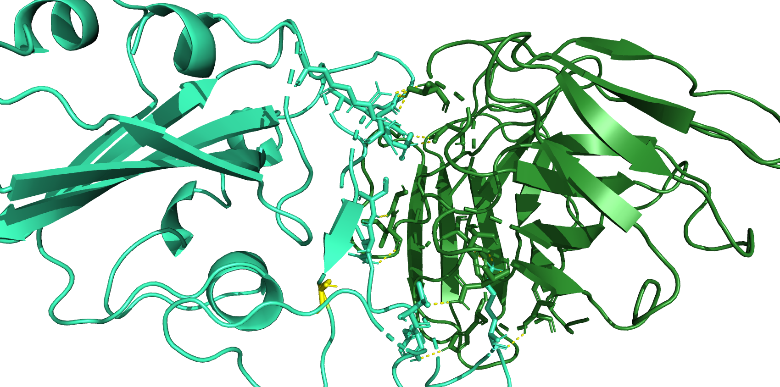
D450
R346
R497
Y449
S493
Q492
S455
K483
T470
Y488

Slide 5
